Slide 1

Clothing ecommerce website

Slide 2
Team 4
Developers:
Hitha Hareendran
Manuel Osoriow
Maryam Janalizadeh

Slide 3
Concept
You have a customer that has a physical store and wants to move everything online and make a web shop. The reason is that your customer has seen a lot of negativity in the news lately that have led to social-distancing measures and business shutting down. Which have significantly disrupted consumer spending habits. While this has created a period of uncertainty for your customer, online shopping has instead been trending in a positive direction. You and your team decided that you want to solve his/hers problem. The customer also needs you to implement checkout process until the actual payment.
He wants the users to be able to pay with cards, swish and Klarna. (You don’t need to actually do it, but at least make a prototype and document on how the process could be).
So, if the customer decided that they want to implement a real world payment systems in the future he will know how much it will cost him in time and finances.

Slide 4
Tools Used
A variety of tools have been used in this project and are listed below:
Adobe XD: to build the wireframe and make the primary design of the website. It was chosen because it’s very popular, responsive, and can be used in the clouds. Therefore, all developers were able to access it and share their ideas.
VisualStudio : to write the HTML / CSS and javascript of the website. The is the best tool in the industry to write websites.
Github: to share the code among developers and keep multiple versions of this project in case unexpected problems happen.
Bootstrap: to building custom frameworks, work with HTML, CSS, JavaScript and design websites faster and easier. ... It also gives us support for JavaScript plugins.
PhotoShop: to range from the full-featured editing of large batches of photos to creating intricate digital paintings and drawings that mimic those done by hand.
ASP.net MVC Pattern: to decouple user-interface (view), data (model), and application logic (controller). It helps to achieve separation of concerns.
NuGet package: to mangae .NET. The NuGet client tools provide the ability to produce and consume packages.
Entity Framework: to work with data using objects of domain specific classes without focusing on the underlying database tables and columns where this data is stored.

Slide 5
Brief description:
This page is intended for use in the Clothing ecommerce.
The customer is supposed to Login, Register as a new customer, become a member, order a Product and fill a billing information, see a summary of his product and price in the same page, payment processing, add and edit product by admin, add and edit and delete customer details information ,rating and reviews , authentication , authorization.

Slide 6
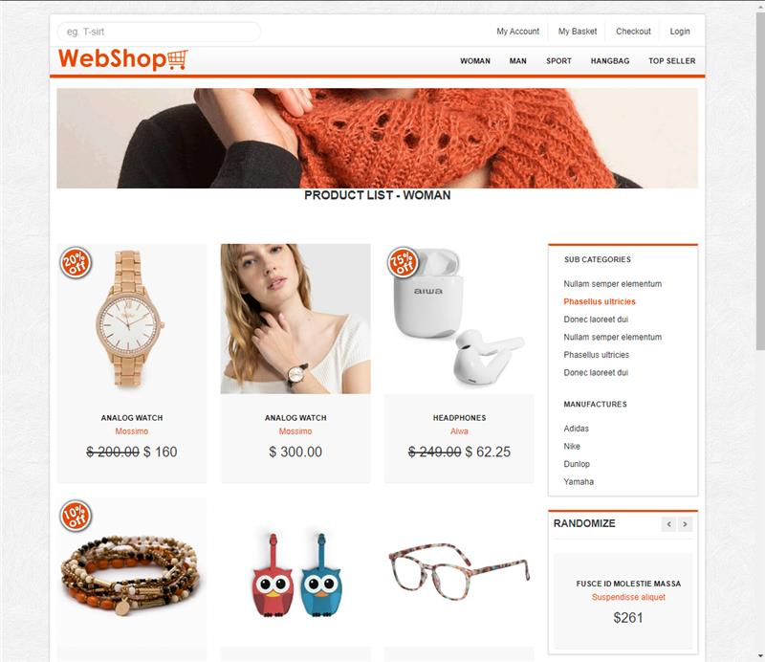
Main Page

Slide 7
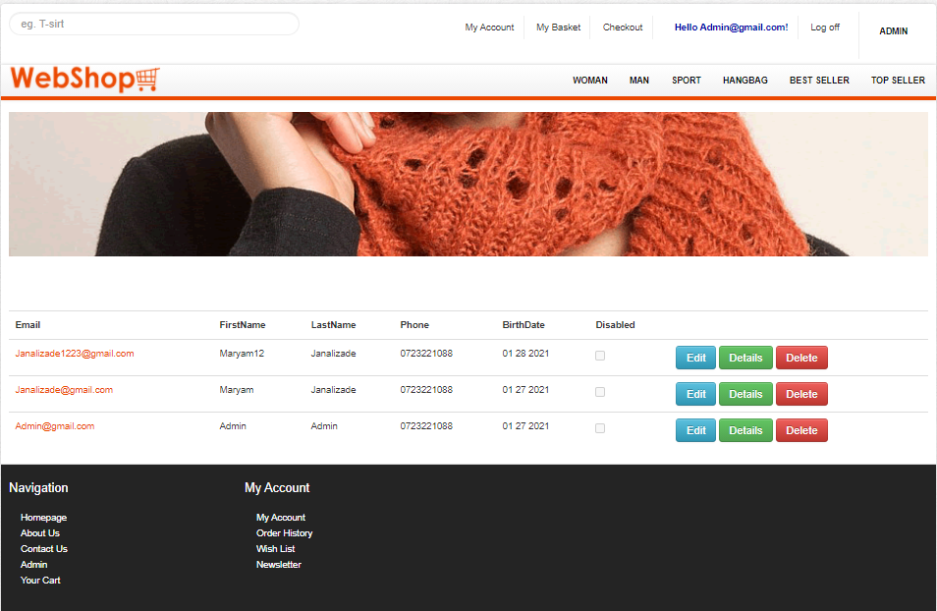
Customer Management The ability to edit ,details and delete and disable customers by Admin.

Slide 8
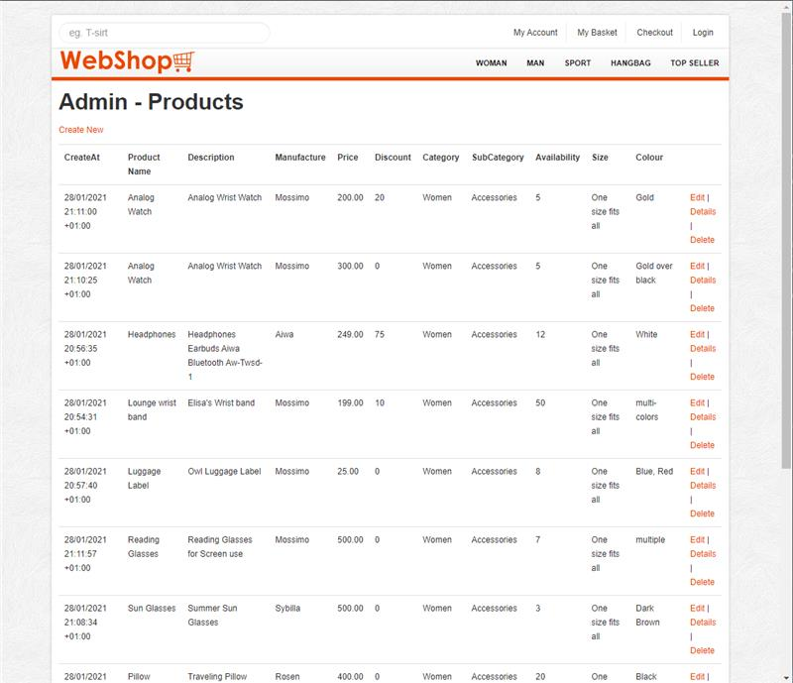
Product Page: The ability to edit ,details and delete products by Admin.

Slide 9
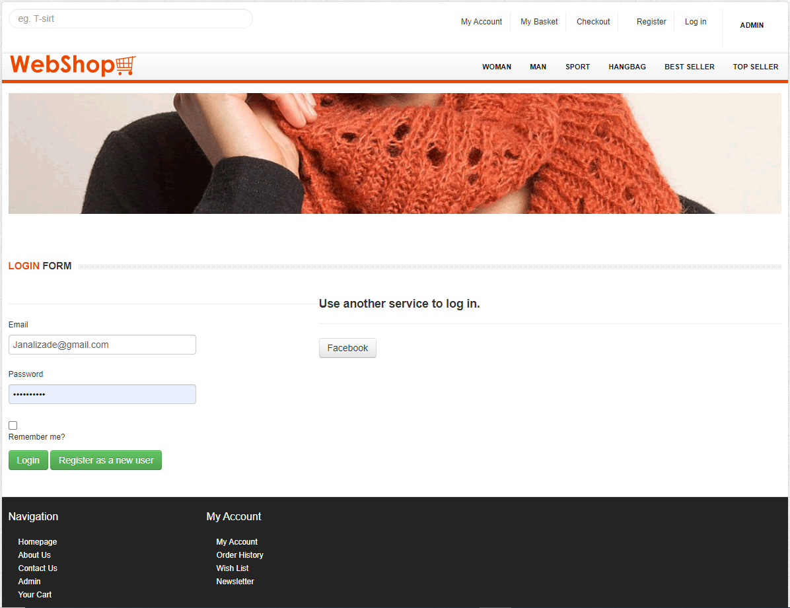
Login It works based on the Asp.net Identity . It has membershipType and access level (SuperAdmin Or Customer) and the ability to use facebook service to log in .

Slide 10
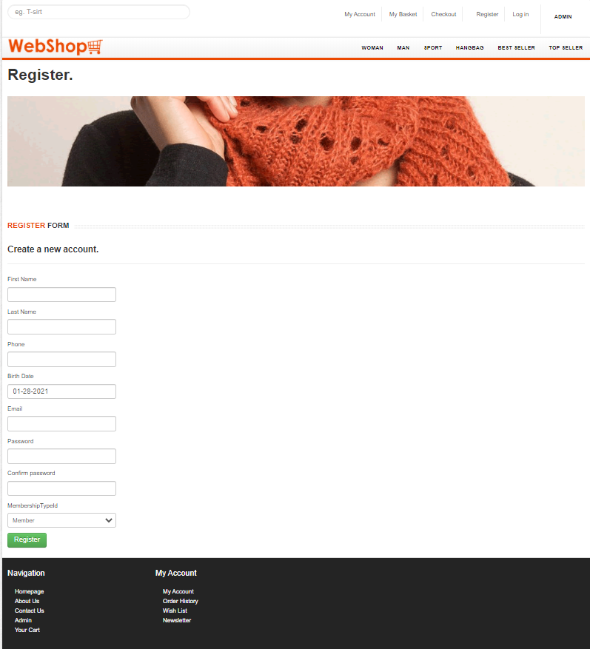
Register Visitors are often prompted with a sign-upform as soon as they enter to eCommerce website.It works based on Membership Access level.

Slide 11
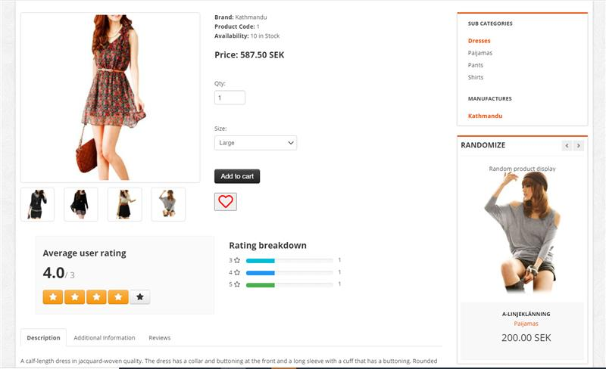
Product Details Page It is a web page on an eCommerce website that provides information on a specific product. This information includes size, color, price, shipping information, reviews, and other relevant information customers want to know before purchasing.

Slide 12
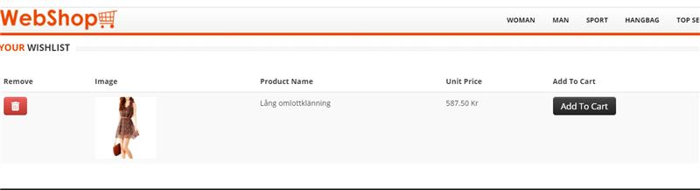
Wish List It is an eCommerce feature that allows shoppers to create personalized ... a product is out-of-stock; a customer has spent some time on a product page

Slide 13
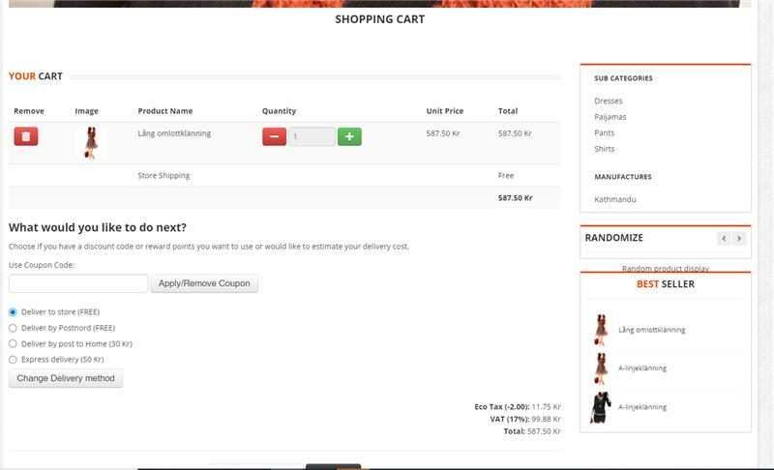
Basket Page: The opportunity to review their cart, modify its contents, assess the total price and choose delivery options.

Slide 14
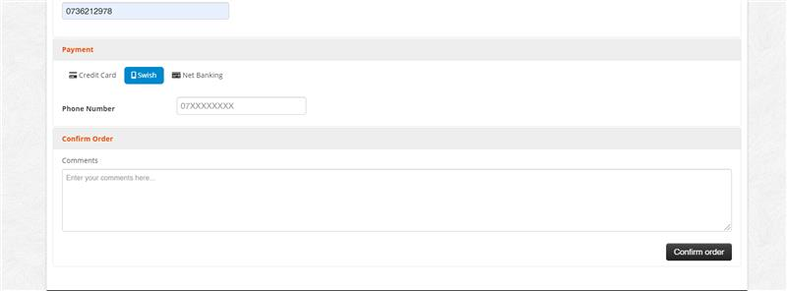
Basket Page:

Slide 15
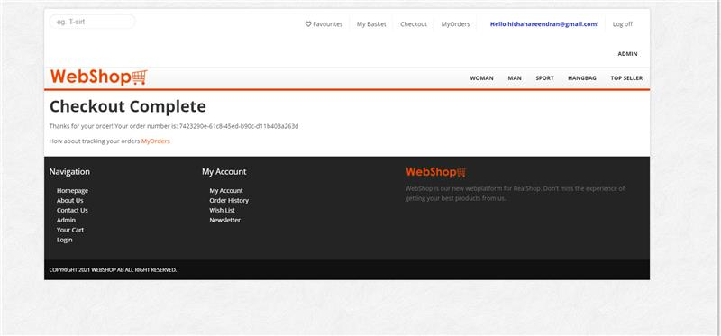
CheckOut Page: It shown to a customer during the step-by-step checkout process. Think of a checkout pages as the online version of a physical checkout counter in a grocery store.

Slide 16
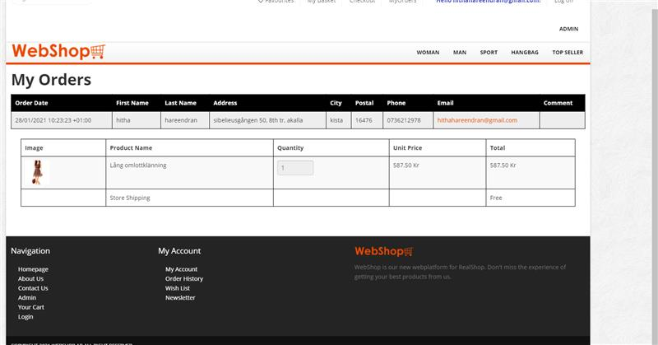
Order Page The Opportunity to review the list of orders by customer.

Slide 17
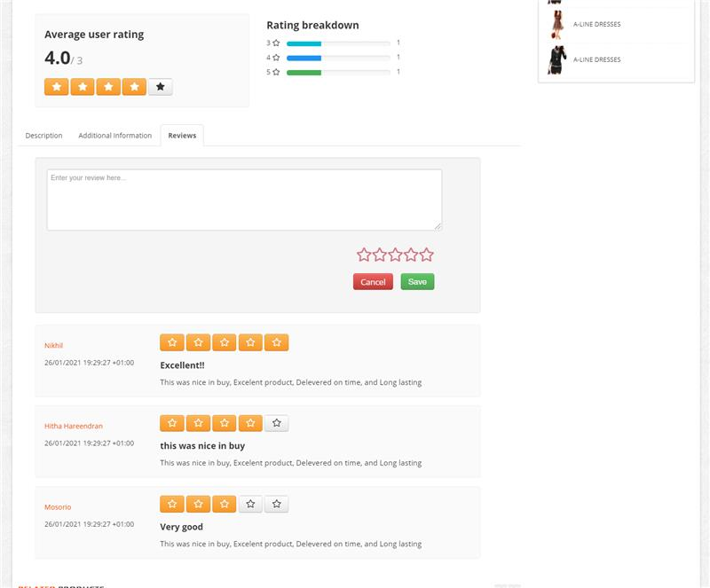
Reviews Part : User reviews are proven sales drivers, and something the majority of customers will want to see before deciding to make a purchase.

Slide 18
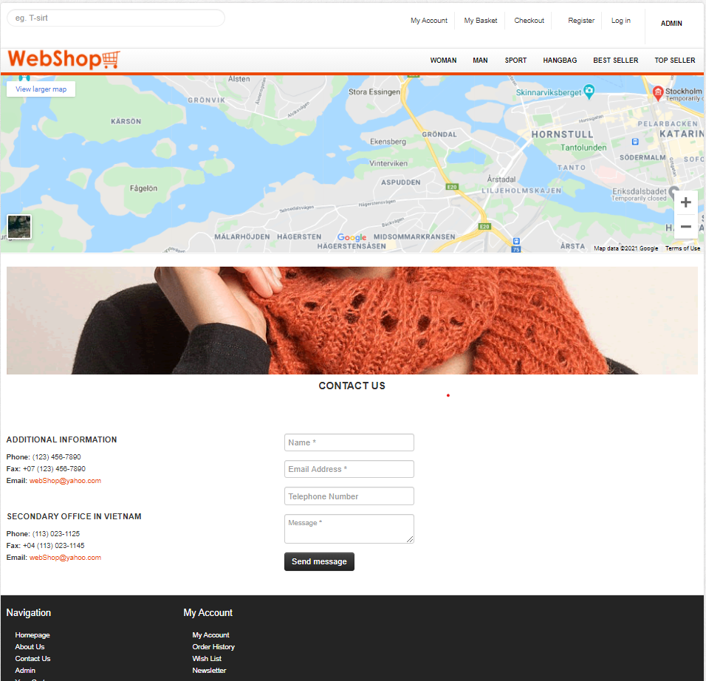
Contact Us Page: The User can send a message to contact the Admin, with the ability of sending ‘noreply’ email to the customer.

